Slide 1
NIE INSTITUTE OF TECHNOLOGY
Department OF computer science ENGINEERING
Cryptocurrency Price Prediction using Machine Learning
PRESENTED BY:
Jagadish V Gaikwad (4NN18CS021)
Nilesh Shrenik Hosure (4NN18CS031)
Shravani M R (4NN18CS042)
Nikita Kulloli (4NN18CS053)
UNDER THE GUIDANCE OF:
Mr. Madhusudan H S

Slide 2
Abstract
After the boom and bust of cryptocurrencies’ prices in recent years, it has been increasingly regarded as an investment asset. Because of its highly volatile nature, there is a need for good predictions on which to base investment decisions. Although existing studies have leveraged machine learning for more accurate Cryptocurrency price prediction, few have focused on the feasibility of applying different modeling techniques to samples with different data structures and dimensional features. To predict Cryptocurrency price at different frequencies using machine learning techniques, I first download the dataset from a trusted website which keeps all the data of various cryptocurrencies then I classify various Cryptocurrencies by the dataset that is according to the available price. I extract the basic trading features acquired from a cryptocurrency exchange are used for 1 month price prediction. Machine learning algorithms including ARIMA and SVR models for Cryptocurrency’s daily price prediction with high-dimensional features achieve an accuracy of 93% and 94% respectively, outperforming more complicated machine learning algorithms. Compared with benchmark results for daily price prediction, I have achieved a better performance, with the highest accuracy of the machine learning algorithm of 97%. Our Hybrid Machine learning model including Support Vector Regression and Autoregressive integrated moving average for One month’s Cryptocurrency price prediction is superior to other Machine learning methods, with accuracy reaching 97%. Our investigation of Cryptocurrency price prediction can be considered a pilot study of the importance of the sample dimension in machine learning techniques.

Slide 3
Introduction:
Bitcoin was proposed by Satoshi Nakamota in 2008.
These are Decentralized digital currency.
These cryptocurrencies can be directly exchanged between 2 individual using Private and Public key
The new Bitcoins are created by mining .
There are more than 2200 different cryptocurrencies are created and traded publicly
The price often fluctuates more then 10%- 30% or even more sometimes
The price of Bitcoin does now not rely on at the business events or intervening government in contrast to the stock market.

Slide 4
Advantages and Disadvantages
Sl.no | Title and Year | Techniques | Advantages | Disadvantages
1 | Bitcoin Price Prediction using Machine Learning Year:2021 | LSTM | Micro economic Features were included in the model for a better predictive results | Higher the batch size the worst the prediction on the test set
2 | Predicting the price of bitcoin using Machine Leaning . Year:2018 | RNN | -------- | Using only RNN will give lesser accuracy(below 50%)
3 | Enhancing bitcoin price Fluctuation prediction using Attentive LSTM and Embedding Network Year:2020 | Attentive LSTM and Embedding Network | Using Embedded networks time consumption is less. | GRU performs better than traditional ML methods

Slide 5
Advantages and Disadvantages
Sl.no | Title and Year | Techniques | Advantages | Disadvantages
4 | Real-time Prediction of Bitcoin Price using ML Techniques and Public Sentiment Analysis Year:2019 | LSTM, ARIMA | Using LSTM gives more appropriate results than any other algorithms. | Due to lack of data testing data was not sufficient for the machine to predict future prices
5 | Systematic Erudition of Bitcoin price prediction using ML techniques Year:2019 | SVM, ARIMA, LSTM | SVM is better than other algorithms | The models are able to predict the binary market movement with accuracies ranging from 50% to 60%
6 | A Research On Bitcoin Price Prediction Using ML Algorithms Year:2020 | Linear Regression, KNN | Linear Regression is the best compared to KNN | It is a long process to filter the data.

Slide 6
Advantages and Disadvantages
Sl.no | Title and Year | Techniques | Advantages | Disadvantages
7 | Crypto-Currency price prediction using Decision Tree and Regression Techniques. Year:2019 | Decision Tree, Linear Regression | Using decision tree they split the data into internal nodes and leaf nodes. | Regression techniques failed to produce outputs.
8 | Bitcoin price prediction in the time of COVID-19. Year:2020 | Random Forest, SVM, Decision Tree, AdaBoost | RF builds multiple decision trees and merges them to get better accuracy. | Support vector machine does not perform well in predicting Bitcoin return or price trend . And lack of Covid data.
9 | A Predictive Model for the Global Cryptocurrency Market Year:2018 | ANN, SVM, Random Forest | ANN’s hidden layer nodes provide strong learning capability. | Less use of dataset resulted in low accuracy rate.

Slide 7
Advantages and Disadvantages
Sl.no | Title and Year | Technique | Advantages | Disadvantages
10 | Bitcoin Price Prediction Using Deep Learning and Real Time Deployment. Year:2020 | LSTM,GRU,SVM | LSTM and GRU were able to provide good accuracy when compared to that of SVM. | SVM produced accuracy in negative digits.
11 | Cryptocurrency Price Prediction Using Neural Networks and Deep Learning. Year:2021 | GRU | Using GRU time consumption is less. | Due to lack of data, testing data was not sufficient for the machine to predict future prices.
12 | Deep Learning-Based Cryptocurrency Price Prediction. Year:2021 | LSTM and GRU | Deep-Learning algorithms have shown accurate results. | GRU performs better than the proposed model.

Slide 8
Problem Statement
Cryptocurrencies are the most complex form of investment, whose values change in every second. Investing money in these is more risk and less profit.
With the new era, current users hope to predict prices of cryptocurrencies for early investment. We will predict the prices for both short period and long period of time. Using various machine learning algorithms.

Slide 9
Methodology
Data Collection.
Data Preprocessing.
Data Scaling Phase.
Model Building Phase.
Model Learning Phase.

Slide 10
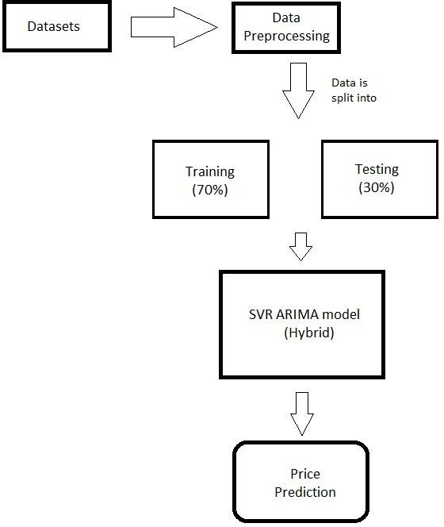
Methodology
Flowchart :

Slide 11
Methodology
SVR (Support Vector Regression):
Support Vector Regression (SVR) works on similar principles as Support Vector Machine (SVM) classification. One can say that SVR is the adapted form of SVM when the dependent variable is numerical rather than categorical. A major benefit of using SVR is that it is a non-parametric technique. Unlike SLR, whose results depend on Gauss-Markov assumptions, the output model from SVR does not depend on distributions of the underlying dependent and independent variables. Instead, the SVR technique depends on kernel functions. Another advantage of SVR is that it permits for construction of a non-linear model without changing the explanatory variables, helping in better interpretation of the resultant model. The basic idea behind SVR is not to care about the prediction as long as the error (ϵi) is less than certain value. This is known as the principle of maximal margin. This idea of maximal margin allows viewing SVR as a convex optimization problem. The regression can also be penalized using a cost parameter, which becomes handy to avoid over-fit. SVR is a useful technique provides the user with high flexibility in terms of distribution of underlying variables, relationship between independent and dependent variables and the control on the penalty term.

Slide 12
Methodology
ARIMA (Autoregressive Integrated Moving Average):
An autoregressive integrated moving average, or ARIMA, is a statistical analysis model that uses time series data to either better understand the data set or to predict future trends.
An autoregressive integrated moving average model is a form of regression analysis that gauges the strength of one dependent variable relative to other changing variables. The model's goal is to predict future securities or financial market moves by examining the differences between values in the series instead of through actual values.
An ARIMA model can be understood by outlining each of its components as follows:
Autoregression (AR): refers to a model that shows a changing variable that regresses on its own lagged, or prior, values.
Integrated (I)represents the differencing of raw observations to allow for the time series to become stationary (i.e., data values are replaced by the difference between the data values and the previous values).
Moving average (MA): incorporates the dependency between an observation and a residual error from a moving average model applied to lagged observations.

Slide 13
Requirement
SOFTWARE/TOOLS
1. LANGUAGE : PYTHON
2. VERSION : PYTHON 3.7
3. TECHNOLOGIES : Pandas, numPy, matplotlib
4. OPERATING SYSTEM : WINDOWS 10
5. RAM : 4GB
6. ROM : MINIMUM STORAGE 5GB OR MORE
7. GRAPHICS : MINIMUM 2GB

Slide 14
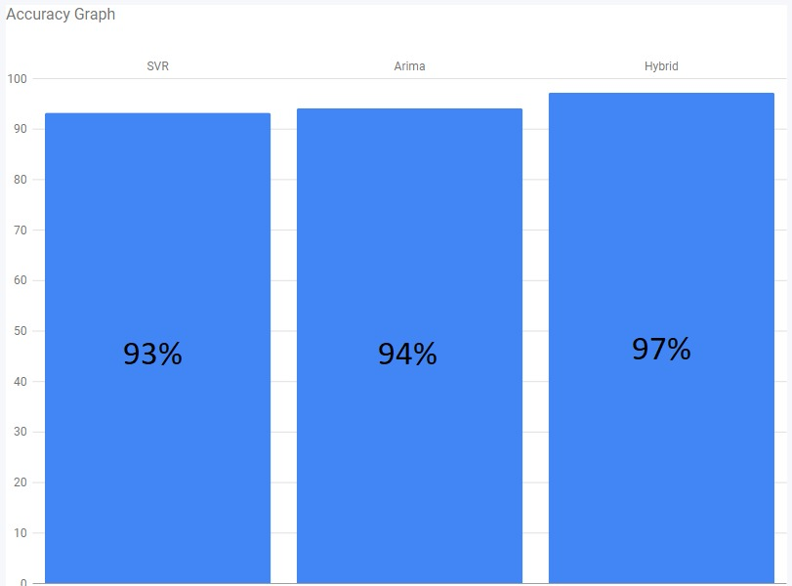
Result
Our hybrid model combines both the models (SVR and ARIMA), we use .merge method to merge both the data frames. Firstly, we run both the models separately and test them then we apply the .merge to combine both the data frames, it only considers the test values of both the algorithms that are same, other values are deleted in this method. Thus, providing us with the better results of both models.

Slide 15
Conclusion
All in all, predicting a price-related variable is difficult given the multitude of forces impacting the market. Add to that, the fact that prices are by a large extent dependent on future prospects rather than historic data. However, using machine learning algorithms has provided us with a better understanding of cryptocurrencies, and ARIMA architecture. Other features can be considered it is essential to predict the future prices of cryptocurrencies as they will help in making more profits and reducing losses. Thus, our proposed model which gives accurate results, can predict the prices of coins, the highest and lowest prices during that period.

Slide 16
Application towards society
The truth is that cryptocurrency is a popular topic. Most people see it as a phenomenon with great relevance. And most individuals are waiting for their present leaders to direct them regarding the future of cryptocurrencies like Bitcoin. But, Bitcoin uses blockchain technology. And this is an innovation that can help deal with ills that affect current society. With this technology, humanity can easily manage and access information about money.
Thus, adopting cryptocurrencies can be an excellent way for society to eliminate ills like corruption. That’s because the community can track any transaction in the public ledger when people use crypto to transfer money. And because you can exchange crypto for any currency, this innovation present the efficiency that current and future society will need. The elimination of third-parties is also a plus because it lows costs while eliminating delays in completing transactions.
Our prediction helps new investors to have a better idea while investing in the cryptocurrencies.

Slide 17
Reference
[1] Mrs Vaidehi M, Alivia Pandit , Bhaskar Jindal , Minu Kumari , Rupali Singh “Bitcoin price prediction using machine learning”. International Journal of Engineering Technologies and Management Research.
[2] Sean McNally,Jason Roche,Simon Caton, “Predicting the Price of Bitcoin Using Machine Learning”.
[3] Yang Li, Zibin Zhen and Hong-Ning Dai “Enhancing Bitcoin Price Fluctuation Prediction Using Attentive LSTM and Embedding Network”.
[4] S M Raju,Ali Mohammad Tarif “Real-Time Prediction of BITCOIN Price using Machine Learning Techniques and Public Sentiment Analysis”, Computer Science, International Islamic University Malaysia, Gombak, Malaysia
[5] Prachi Vivek Rane,Sudhir N Dhage “Systematic Erudition of Bitcoin Price Prediction using Machine Learning Techniques”, ICACCS conference.
[6] Lekkala Sreekanth Reddy, Dr.P. Sriramya “A Research On Bitcoin Price Prediction Using Machine Learning Algorithms”.
[7] Karunya Rathan, Somarouthu Venkat Sai , Tubati Sai Manikanta “Crypto-Currency price prediction using Decision Tree and Regression techniques” ,IEEE papers
[8] Ash Demir,Beyza Nur Akilotu,Zehra Kadiroglu,Abdulkadir Sengur “Bitcoin Price Prediction Using Machine Learning Techniques”, IEEE papers.

Slide 18
Reference
[9] E. Mahendra, H. Madan; S. Gupta, S. V. Singh “Bitcoin Price Prediction Using Deep Learning and Real Time Deployment.”
[10] Minul Wimalagunaratne, Guhanathan Poravi “A Predictive Model for the Global Cryptocurrency Market: A Holistic Approach to Predicting Cryptocurrency Prices.”
[11] Sudeep Tanwar, Nisarg P. Patel, Smit N. Patel, Jil R. Patel, Gulshan Sharma, Innocent E. Davidson “Deep Learning-Based Cryptocurrency Price Prediction Scheme With Inter-Dependent Relations.”
[12] Lekkala Sreekanth Reddy, Dr.P. Sriramya “A Research On Bitcoin Price Prediction Using Machine Learning Algorithms”

